Slide 1
Programming with Parallel Migratable Objects
Sanjay Kalé and PPL
Parallel Programming Laboratory
University of Illinois at Urbana-Champaign

Slide 2
Manual: http://charm.cs.illinois.edu/manuals/html/charm++/manual.html
Installation: http://charm.cs.illinois.edu/manuals/html/charm++/A.html

Slide 3
Outline
Introduction
Object Design
Execution Model
Hello World
Benefits of Charm++
Charm++ Basics
Object Collections
Overdecomposition
Migratability
Checkpointing and Resilience
Structured Dagger
Application Design
Performance Tuning
Using Dynamic Load Balancing
Interoperability
Debugging
Further Optimization

Slide 4
Harnessing Parallelism: Challenges Trends in System Architecture
Frequencies have stopped increasing
Memory costs are high
Relatively low per core memory
Increasing heterogeneity
Accelerators, SMT
Energy, power, and thermal considerations
Frequent component failures

Slide 5

Harnessing Parallelism: Challenges Trends in System Architecture
However, compute resources are not faster cores, but more cores
Unprecedented levels of available concurrency
IBM BG/Q
‘Sequoia’: 1,572,864 cores
‘Mira’: 786,432 cores
Cray
XE6+XK6 ‘Bluewaters‘: 386,816 cores
XK6 ‘Titan’: 299,008 cores
K Supercomputer: 705,024 cores
Mid-size clusters will be ubiquitous
Implications
Each thread of execution has to:
Operate on lesser data
Wait relatively longer for remote data
Have to operate in strong scaling regime

Slide 6
Harnessing Parallelism: Challenges Next-generation Applications
Need for strong scaling
Faster solutions (not just larger problems)
Application Characteristics
Multi-resolution
Adaptive, spatial and temporal resolutions
Dynamic/adaptive refinements: to handle application variation
Multi-module (multi-physics)
Complex physics in multiple, interacting modules
Adapt to a volatile computational environment
Exploit heterogeneous architecture
Deal with thermal and energy considerations
So? Consequences:
Must support automated resource management
Must support interoperability and parallel composition

Slide 7
Harnessing Parallelism: Challenges Programming Models: MPI
Highly successful
Universally used
Has supported application evolution from gigascale to petascale
Library
Communication primitives
MPI does not directly support automated resource management (e.g. load balancing, fault tolerance, etc.)

Slide 8
Charm++ builds upon a proven approach: objects

Slide 10
Stuff you already know Benefits of Object-based code
Objects encapsulate data
Methods represent functionality relevant to that data
Method invocations can modify / update state of the object / data
Computation can be expressed in terms of objects interacting via method invocations
Methods are natural units of sequential computation on object data
Thoughtful design yields focused methods with single purpose
Naturally expresses an object’s response to inputs (signals / data)
Nothing new
Still quite uncommon in HPC code
Its not about language syntax. Its about program structure

Slide 11
Globally-Visible Objects: Chares and Proxies
2
8
4
Parallel Address Space
6
F
C
E
G
B
D
H
A
0
3
7
5
9
1
Certain “special” object instances are:
first-class citizens in the parallel address space,
with unique location-independent names
Under the hood, the runtime handles locality and provides the mechanisms to promote objects to the parallel space

Slide 12
Globally-Visible Methods: Entry Methods
Parallel Address Space
F.m4()
E.m1()
G
F
C
E.m3()
E
G.m2()
B.m2()
B
D
H.m2()
A
H
How can objects communicate across address spaces?
Just like a sequential object-oriented language, an object’s reference is used to invoke a method
In the parallel space, this is a handle that is location transparent
A method invocation becomes an act of communication

Slide 13
Method-Driven Asynchronous Communication
What happens if an object waits for a return value from a method invocation?
Performance
Latency
Reasoning about correctness

Slide 14
Design Principle: Do not wait for remote completion
Hence, method invocations should be asynchronous
No return values
Computations are driven by the incoming data
Initiated by the sender or method caller

Slide 15
For example, a Jacobi reduction

Slide 16
Methods: Natural Units of Sequential Computation
Methods still have the same sequential semantics
Atomicity: methods do not execute in parallel
Methods cannot be interrupted or preempted
Methods interact and update state of an object in the same way
Method sequencing is what changes from sequential computation

Slide 17
The Execution Model
Several objects live on a single PE
For now, think of it as a core (or just “processor”)
As a result,
Method invocations directed at objects on that processor will have to be stored in a pool,
And a user-level scheduler will select one invocation from the queue and runs it to completion
A PE is the entity that has one scheduler instance associated with it
Notes:
Made image from slides from presentation I made with these objects: loadBalancingBasics_SMD.pptx

Slide 18
The Execution Model
Execution is triggered by availability of a “message” (a method invocation)
When an entry method executes,
it may generate messages for other objects
the RTS deposits them in the message Q on the target processor
Notes:
Made image from slides from presentation I made with these objects: loadBalancingBasics_SMD.pptx

Slide 19
Outline
Introduction
Object Design
Execution Model
Hello World
Benefits of Charm++
Charm++ Basics
Object Collections
Overdecomposition
Migratability
Checkpointing and Resilience
Structured Dagger
Application Design
Performance Tuning
Using Dynamic Load Balancing
Interoperability
Debugging
Further Optimization

Slide 20
Hello World Example
hello.ci file
mainmodule hello {
mainchare Main {
entry Main(CkArgMsg ∗m);
};
};
hello.cpp file
#include <stdio.h>
#include ”hello.decl.h”
class Main : public CBase Main {
public: Main(CkArgMsg∗ m) {
ckout << ”Hello World!” << endl;
CkExit();
};
};
#include ”hello.def.h”

Slide 21
Hello World with Chares
hello.cpp file
#include <stdio.h>
#include ”hello.decl.h”
class Main : public CBase Main {
public: Main(CkArgMsg∗ m) {
CProxy Singleton::ckNew();
};
};
class Singleton : public
CBase Singleton {
public: Singleton() {
ckout << ”Hello World!” << endl;
CkExit();
};
};
#include ”hello.def.h”
hello.ci file
mainmodule hello {
mainchare Main {
entry Main(CkArgMsg ∗m);
};
chare Singleton {
entry Singleton();
};
};

Slide 22
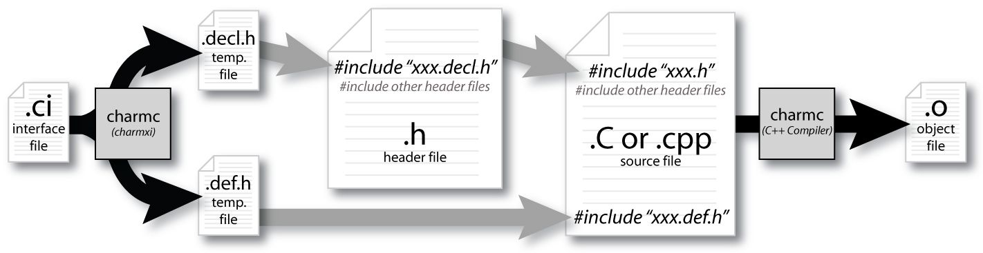
Compiling a Charm++ Program

Slide 23
Building Charm++
git clone http://charm.cs.uiuc.edu/gerrit/charm
./build <TARGET> <ARCH> <OPTS>
TARGET = Charm++, AMPI, bgampi, LIBS etc.
ARCH = net-linux-x86 64, multicore-darwin-x86 64, pamilrts-bluegeneq etc.
OPTS = –with-production, –enable-tracing, xlc, smp, -j8 etc.
http://charm.cs.illinois.edu/manuals/html/charm++/A.html

Slide 24
Hello World Example
Compiling
charmc hello.ci
charmc -c hello.C
charmc -o hello hello.o
Running
./charmrun +p7 ./hello
The +p7 tells the system to use seven cores

Slide 25
Outline
Introduction
Object Design
Execution Model
Hello World
Benefits of Charm++
Charm++ Basics
Object Collections
Overdecomposition
Migratability
Checkpointing and Resilience
Structured Dagger
Application Design
Performance Tuning
Using Dynamic Load Balancing
Interoperability
Debugging
Further Optimization

Slide 26
Impact on communication
Current use of communication network
Compute-communicate cycles in typical MPI apps
Network is used for a fraction of time
And is on the critical path
Hence, current communication networks are over-engineered by necessity
With overdecomposition
Communication is spread over an iteration
Adaptive overlap of communication and computation

Slide 27
Example Computation
Consider a simple stencil computation
With traditional design based on traditional methods (e.g. MPI-based)
Each processor has a chunk, which alternates between computing and communicating
With Charm++
Multiple chunks on each processor
Wait time for each chunk overlapped with useful computation for others
Communication spread over time

Slide 28
Example: Stencil Computation
Stencil in MPI: No overlap among computation and communication
Stencil in Charm: Communication of a chare overlaps with computation of others

Slide 29
Modularity and Compositionality
Without message-driven execution (and virtualization), you get either: Space-division

Slide 30
Modularity and Compositionality
Sequentialization

Slide 31
Modularity and Compositionality
Parallel Composition: A1; (B —— C ); A2
Recall: Different modules, written in different languages/paradigms, can overlap in time and on processors, without programmer having to worry about this explicitly

Slide 32
Migratability
Once the programmer has written the code without reference to processors, all of the communication is expressed among objects
The system is free to migrate the objects across processors as and when it pleases
It must ensure it can deliver method invocations to the objects, whereever they go
This migratability turns out to be a key attribute for empowering an adaptive runtime system

Slide 33
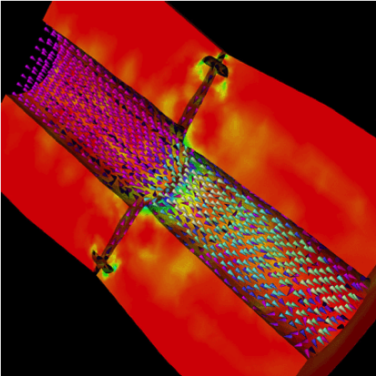
Decomposition Independent of numCores
Rocket simulation under traditional MPI
Rocket simulation with migratable objects
Benefits: load balance, communication optimizations, modularity

Slide 34
Utility for Multi-cores, Many-cores, Accelerators
Objects connote and promote locality Message-driven execution is
A strong principle of prediction for data and code use
Much stronger than principle of locality
Can be used to scale memory wall
Prefetching of needed data, e.g, into scratch pad memories
Notes:
Made image from slides from presentation I made with these objects: loadBalancingBasics_SMD.pptx

Slide 35
Load Balancing
Static
Irregular applications
Programmer shouldn’t have to figure out ideal mapping
Dynamic
Applications are increasingly using adaptive strategies
Abrupt refinements
Continuous migration of work: e.g. particles in MD
Challenges
Performance limited by most overloaded processor
The chance that one processor is severely overloaded gets higher as #processors increases
Migratable Objects Empower Automated Load Balancing!

Slide 36
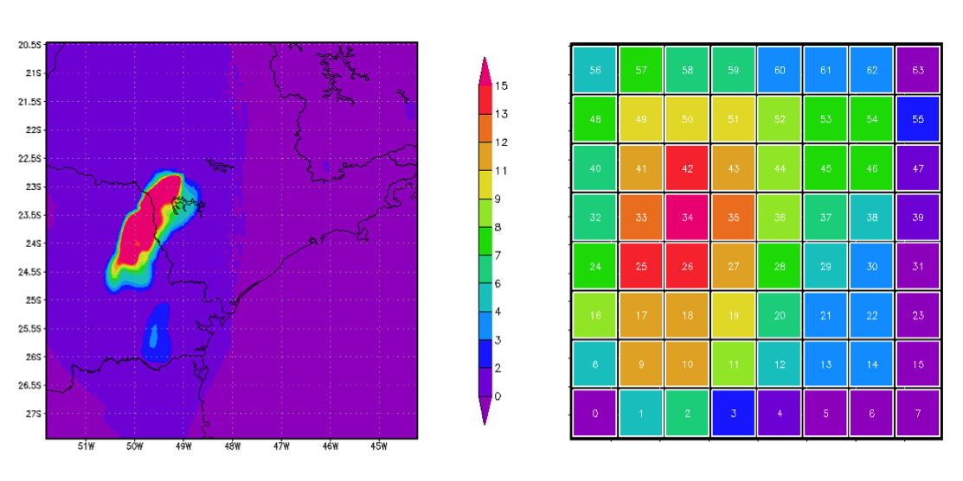
A quick Example Weather Forecasting in BRAMS
Brams: Brazillian weather code (based on RAMS)
AMPI version (Eduardo Rodrigues, with Mendes and J. Panetta)

Slide 37
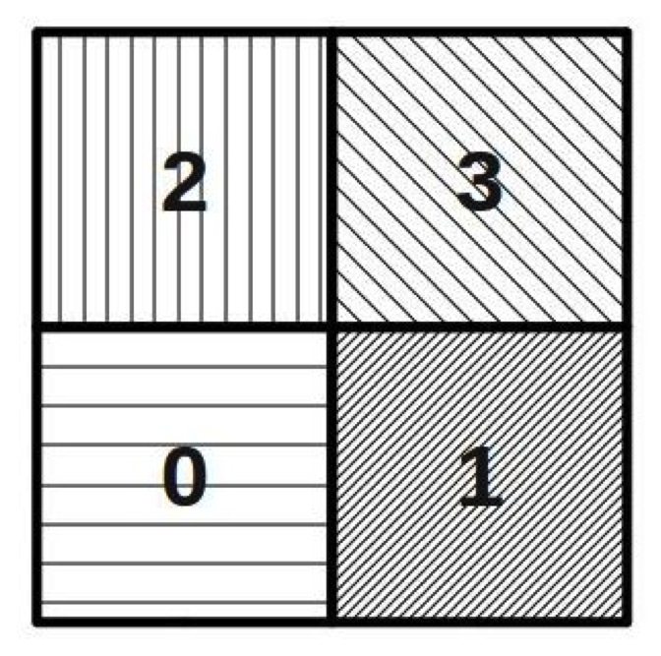
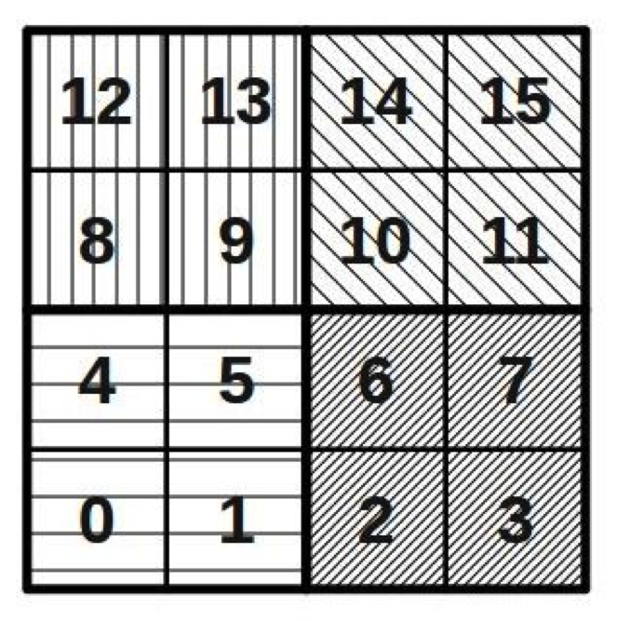
Basic Virtualization of BRAMS

Slide 38
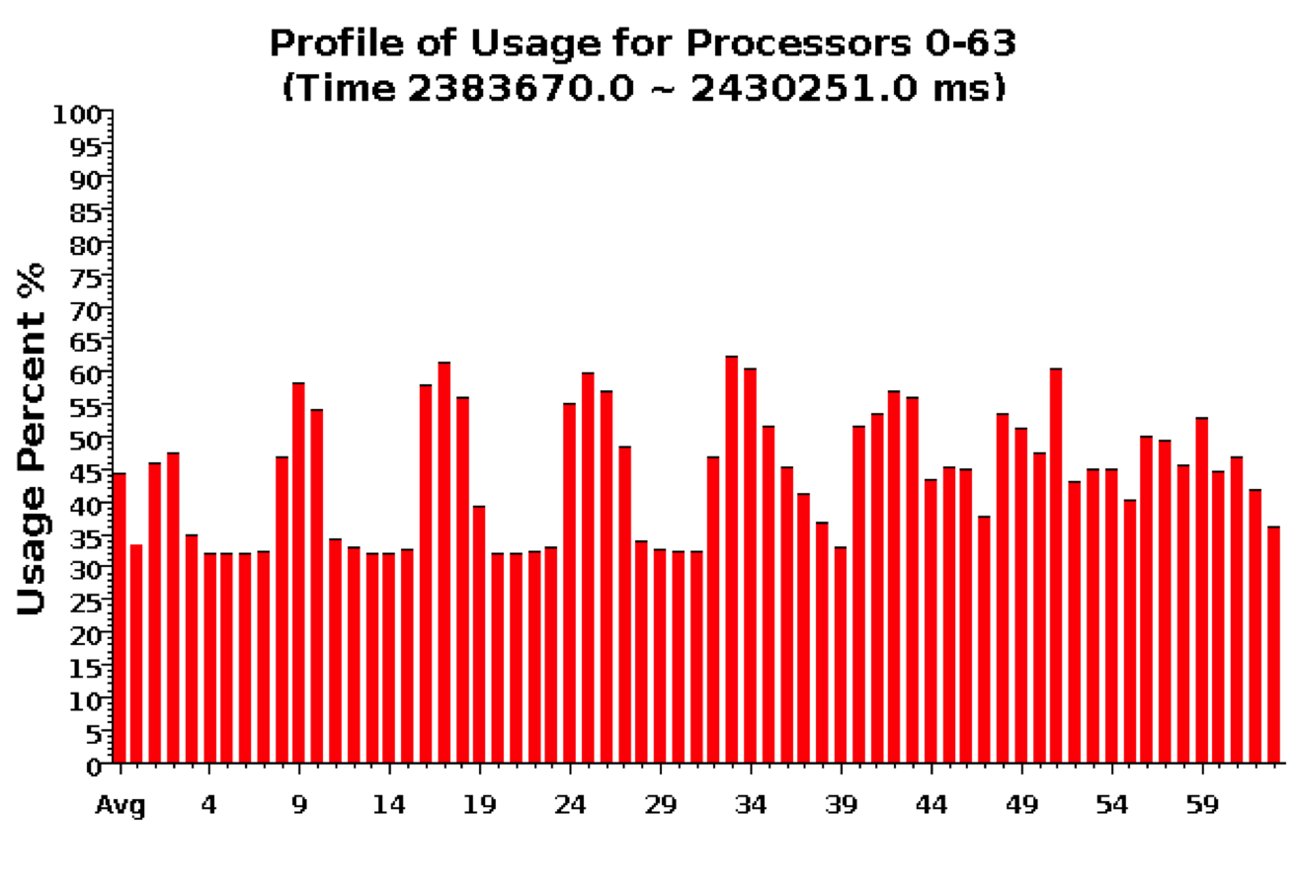
Baseline: 64 objects on 64 processors

Slide 39
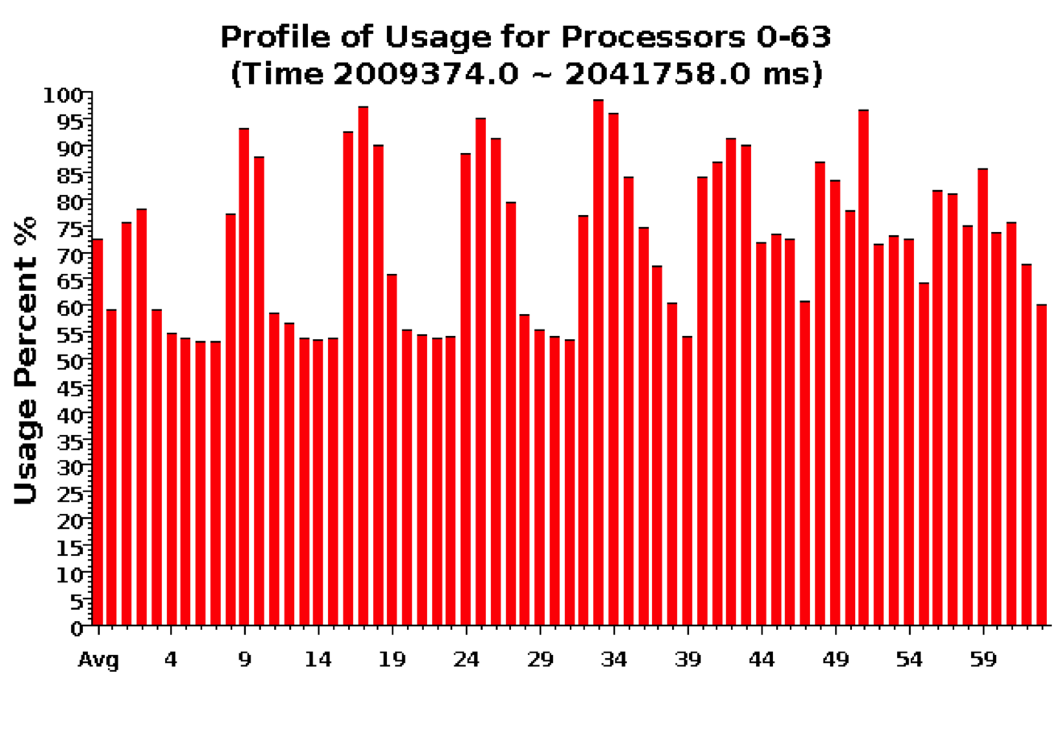
Over-decomposition: 1024 objects on 64 processors Benefits from communication/computation overlap

Slide 40
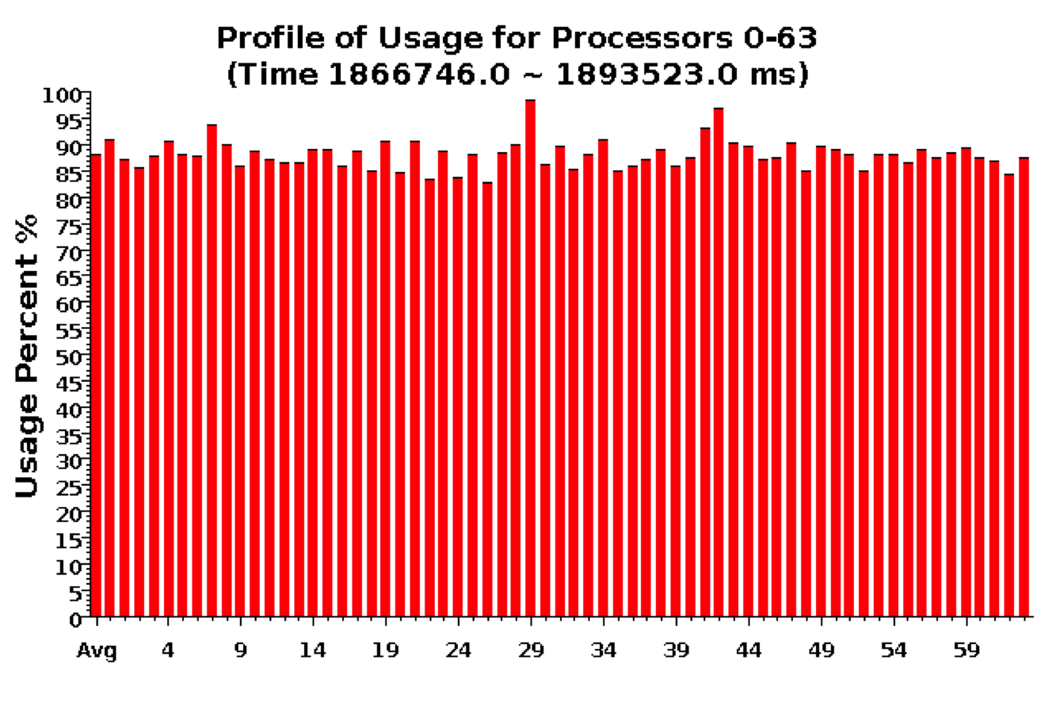
With Load Balancing: 1024 objects on 64 processors
No overdecomp (64 threads): 4988 sec
Overdecomp into 1024 threads: 3713 sec
Load balancing (1024 threads): 3367 sec

Slide 41
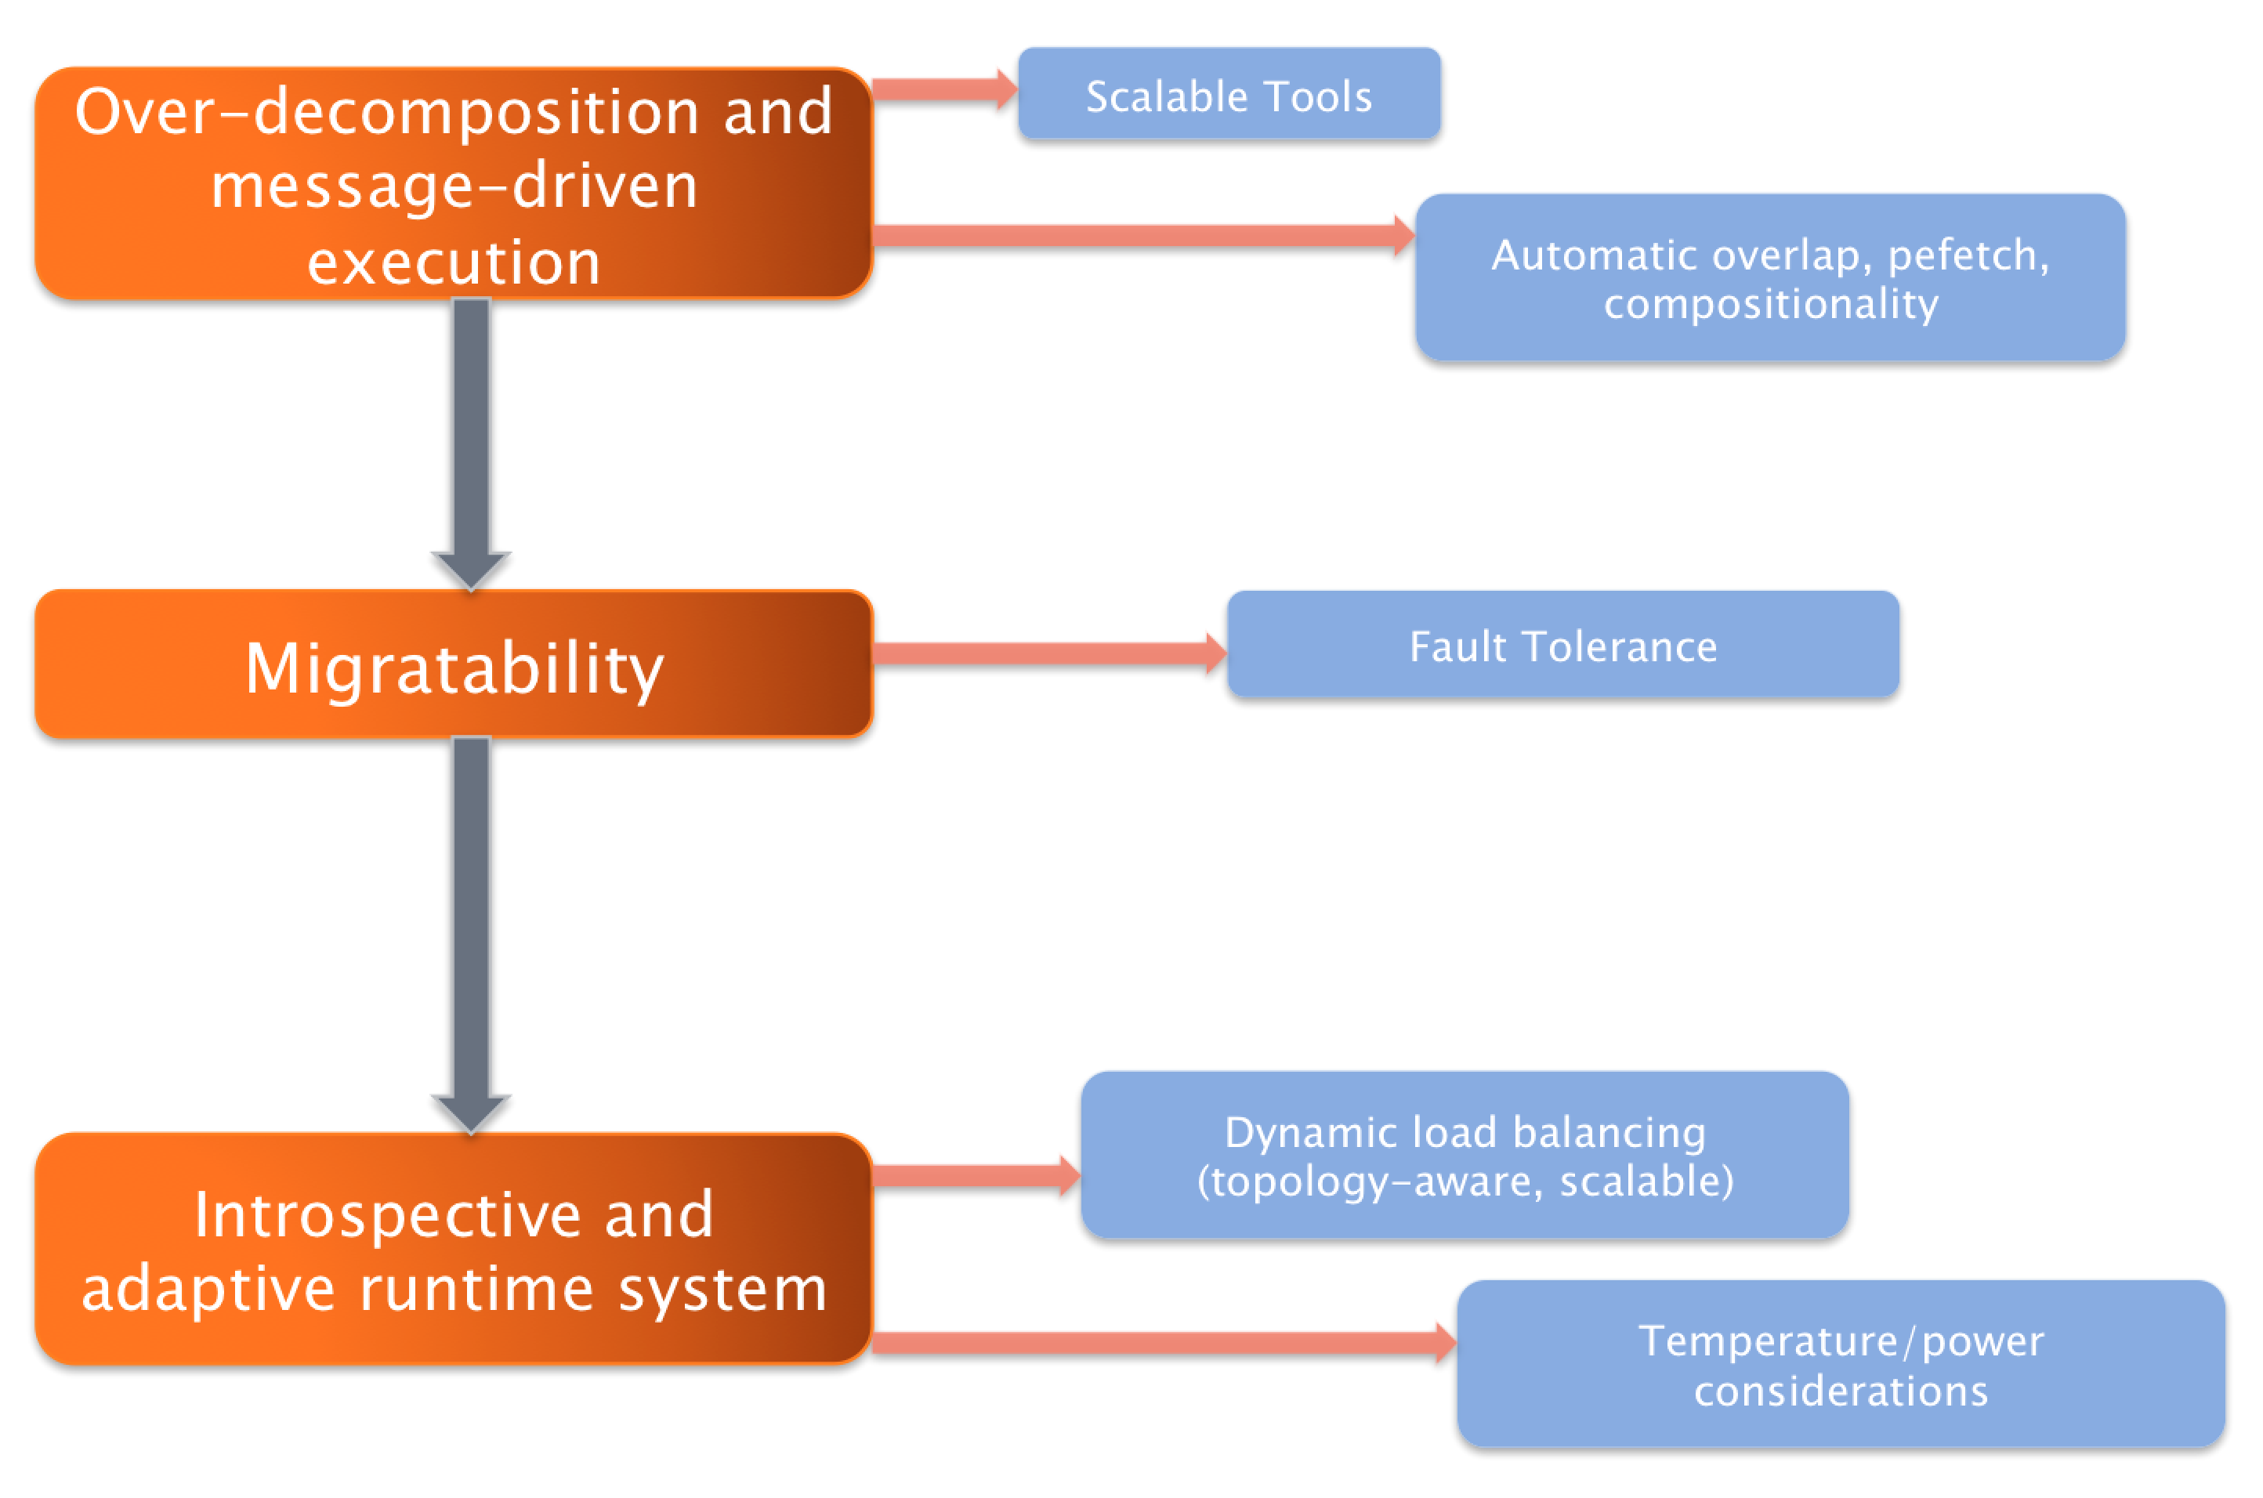

Slide 42
Outline
Introduction
Object Design
Execution Model
Hello World
Benefits of Charm++
Charm++ Basics
Object Collections
Overdecomposition
Migratability
Checkpointing and Resilience
Structured Dagger
Application Design
Performance Tuning
Using Dynamic Load Balancing
Interoperability
Debugging
Further Optimization

Slide 43
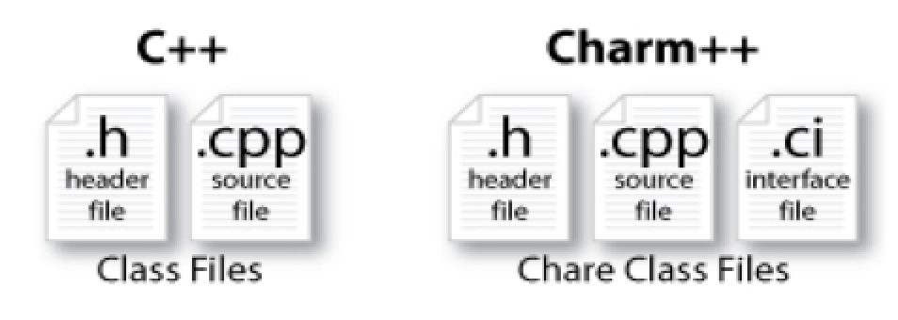
Charm++ File structure
C++ objects (including Charm++ objects)
Defined in regular .h and .C files
Chare objects, entry methods (asynchronous methods)
Defined in .ci file
Implemented in the .C file

Slide 44
Charm Interface: Modules
Charm++ programs are organized as a collection of modules
Each module has one or more chares
The module that contains the mainchare, is declared as the mainmodule
Each module, when compiled, generates two files:
MyModule.decl.h and MyModule.def.h
.ci file
[main]module MyModule {
//... chare definitions ...
};

Slide 45
Charm Interface: Chares
Chares are parallel objects that are managed by the RTS
Each chare has a set entry methods, which are asynchronous methods that may be invoked remotely
The following code, when compiled, generates a C++ class CBase MyChare that encapsulates the RTS object
This generated class is extended and implemented in the .C file
.ci file
[main]chare MyChare {
//... entry method definitions ...
};
.C file
class MyChare : public CBase MyChare {
//... entry method implementations ...
};

Slide 49
Outline
Introduction
Object Design
Execution Model
Hello World
Benefits of Charm++
Charm++ Basics
Object Collections
Overdecomposition
Migratability
Checkpointing and Resilience
Structured Dagger
Application Design
Performance Tuning
Using Dynamic Load Balancing
Interoperability
Debugging
Further Optimization

Slide 50
Chares are reactive
The way we described Charm++ so far, a chare is a reactive entity:
If it gets this method invocation, it does this action,
If it gets that method invocation then it does that action
But what does it do?
In typical programs, chares have a life-cycle
How to express the life-cycle of a chare in code?
Only when it exists
i.e. some chars may be truly reactive, and the programmer does not know the life cycle
But when it exists, its form is:
Computations depend on remote method invocations, and completion of other local computations
A DAG (Directed Acyclic Graph)!

Slide 51
Fibonacci Example
mainmodule fib {
mainchare Main {
entry Main(CkArgMsg∗ m);
};
chare Fib {
entry Fib(int n, bool isRoot, CProxy Fib parent);
entry void respond(int value);
};
};

Slide 52
Fibonacci Example
class Main : public CBase Main {
public: Main(CkArgMsg∗ m) {
CProxy Fib::ckNew(atoi(m−>argv[1]), true, CProxy Fib());
}
};
class Fib : public CBase Fib {
public: CProxy Fib parent; bool isRoot; int result, count;
Fib(int n, bool isRoot , CProxy Fib parent )
: parent(parent ), isRoot(isRoot ), result(0), count(2) {
if (n < 2) respond(n);
else {
CProxy Fib::ckNew(n − 1, false, thisProxy);
CProxy Fib::ckNew(n − 2, false, thisProxy);
}
}
void respond(int val) {
result += val;
if (−−count == 0 || n < 2) {
if (isRoot) {
CkPrintf(”Fibonacci number is: %d\n”, result);
CkExit();
} else
{ parent.respond(result);
delete this;
}
}
}
};

Slide 53
Consider Fibonacci Chare
The Fibonacci chare gets created
If its not a leaf,
It fires two chares
When both children return results (by calling respond ):
It can compute my result and send it up, or print it
But in our, this logic is hidden in the flags and counters . . .
This is simple for this simple example, but . . .
Lets look at how this would look with a little notational support

Slide 54
Structured Dagger The when construct
The when construct
Declare the actions to perform when a message is received
In sequence, it acts like a blocking receive
entry void someMethod() {
when entryMethod1(parameters) { /∗ block2 ∗/ }
when entryMethod2(parameters) { /∗ block3 ∗/ }
};

Slide 55
Structured Dagger The serial construct
The serial construct
A sequencial block of C++ code in the .ci file
The keyword serial means that the code block will be executed without interruption/preemption, like an entry method
Syntax serial <optionalString> { /* C++ code */ }
The <optionalString> is used for identifying the serial for performance analysis
Serial blocks can access all members of the class they belong to
Examples (.ci file):
entry void method1(parameters) {
serial
{ thisProxy.invokeMethod(10);
callSomeFunction();
}
};
entry void method2(parameters) {
serial ”setValue” {
value = 10;
}
};

Slide 56
Structured Dagger The when construct
entry void someMethod() {
serial { /∗ block1 ∗/ }
when entryMethod1(parameters) serial { /∗ block2 ∗/ }
when entryMethod2(parameters) serial { /∗ block3 ∗/ }
};
Sequence
Sequentially execute /* block1 */
Wait for entryMethod1 to arrive, if it has not, return control back to the Charm++ scheduler, otherwise, execute /* block2 */
Wait for entryMethod2 to arrive, if it has not, return control back to the Charm++ scheduler, otherwise, execute /* block3 */

Slide 57
Structured Dagger The when construct
Execute /* further sdag */ when myMethod arrives
when myMethod(int param1, int param2)
/∗ further code ∗/
Execute /* further sdag */ when myMethod1 and myMethod2 arrive
when myMethod1(int param1, int param2),
myMethod2(bool param3)
/∗ further code ∗/
Which is almost the same as this:
when myMethod1(int param1, int param2) {
when myMethod2(bool param3) { }
}
/* further code */

Slide 58
Structured Dagger Boilerplate
Structured Dagger can be used in any entry method (except for a constructor)
Can be used in a mainchare , chare , or array
For any class that has Structured Dagger in it you must insert two calls:
The Structured Dagger macro: [ClassName] SDAG CODE
For later: call the sdag pup() in the pup method

Slide 59
Structured Dagger Boilerplate
The .ci file:
The .cpp file:
[mainchare,chare,array] MyFoo {
…
entry void method(parameters) {
// … structured dagger code here …
};
…
}
class MyFoo : public CBase MyFoo {
MyFoo SDAG_Code/* insert SDAG macro */
public:
MyFoo() { }
};

Slide 60
Fibonacci with Structured Dagger
mainmodule fib {
mainchare Main {
entry Main(CkArgMsg∗ m);
};
chare Fib {
entry Fib(int n, bool isRoot, CProxy Fib parent);
entry void calc(int n) {
if (n < THRESHOLD) serial { respond(seqFib(n)); }
else {
serial {
CProxy Fib::ckNew(n − 1, false, thisProxy);
CProxy Fib::ckNew(n − 2, false, thisProxy);
}
when response(int val)
when response(int val2)
serial { respond(val + val2); }
}
};
entry void response(int);
};
};

Slide 61
Fibonacci with Structured Dagger
Fibonacci with Structured Dagger
#include ”fib.decl.h”
#define THRESHOLD 10
class Main : public CBase Main {
public: Main(CkArgMsg∗ m) { CProxy Fib::ckNew(atoi(m−>argv[1]), true, CProxy Fib()); }
};
class Fib : public CBase Fib {
public:
Fib SDAG CODE
CProxy Fib parent; bool isRoot;
Fib(int n, bool isRoot , CProxy Fib parent )
: parent(parent ), isRoot(isRoot ) {
calc(n);
}
int seqFib(int n) { return (n < 2) ? n : seqFib(n − 1) + seqFib(n − 2); }
void respond(int val) {
if (!isRoot)
{ parent.response(val);
delete this;
} else {
CkPrintf(”Fibonacci number is: %d\n”, val);
CkExit();
}
}
};
#include “fib.def.h”

Slide 62
Structured Dagger The when construct
What is the sequence?
when myMethod1(int param1, int param2) {
when myMethod2(bool param3),
myMethod3(int size, int arr[size]) /∗ sdag block1 ∗/
when myMethod4(bool param4) /∗ sdag block2 ∗/
}
Sequence:
Wait for myMethod1 , upon arrival execute body of myMethod1
Wait for myMethod2 and myMethod3 , upon arrival of both, execute /* sdag block1 */
Wait for myMethod4 , upon arrival execute /* sdag block2 */
Question: if myMethod4 arrives first what will happen?

Slide 63
Structured Dagger The when construct
The when clause can wait on a certain reference number
If a reference number is specified for a when , the first parameter for the when must be the reference number
Semantic: the when will “block” until a message arrives with that reference number
when method1[100](int ref, bool param1)
/∗ sdag block ∗/
serial {
proxy.method1(200, false); /∗ will not be delivered to the when ∗/
proxy.method1(100, true); /∗ will be delivered to the when ∗/
}

Slide 64
Structured Dagger The if-then-else construct
The if-then-else construct:
Same as the typical C if-then-else semantics and syntax
if (thisIndex.x == 10) {
when method1[block](int ref, bool someVal) /∗ code block1 ∗/
} else {
when method2(int payload) serial {
//... some C++ code
}
}

Slide 65
Structured Dagger The for construct
The for construct:
Defines a sequenced for loop (like a sequential C for loop)
Once the body for the ith iteration completes, the i + 1 iteration is started
for (iter = 0; iter < maxIter; ++iter) {
when recvLeft[iter](int num, int len, double data[len])
serial { computeKernel(LEFT, data); }
when recvRight[iter](int num, int len, double data[len])
serial { computeKernel(RIGHT, data); }
}
iter must be defined in the class as a member
class Foo : public CBase Foo {
public: int iter;
};

Slide 66
Structured Dagger The while construct
The while construct:
Defines a sequenced while loop (like a sequential C while loop)
while (i < numNeighbors) {
when recvData(int len, double data[len]) {
serial {
/∗ do something ∗/
}
when method1() /∗ block1 ∗/
when method2() /∗ block2 ∗/
}
serial { i++; }
}

Slide 67
Structured Dagger The overlap construct
The overlap construct:
By default, Structured Dagger defines a sequence that is followed sequentially
overlap allows multiple independent clauses to execute in any order
Any constructs in the body of an overlap can happen in any order
An overlap finishes in sequence when all the statements in it are executed
Syntax overlap { /* sdag constructs */ }
What are the possible execution sequences?
serial { /∗ block1 ∗/ }
overlap {
serial { /∗ block2 ∗/ }
when entryMethod1[100](int ref num, bool param1) /∗ block3 ∗/
when entryMethod2(char myChar) /∗ block4 ∗/
}
serial { /∗ block5 ∗/ }

Slide 68
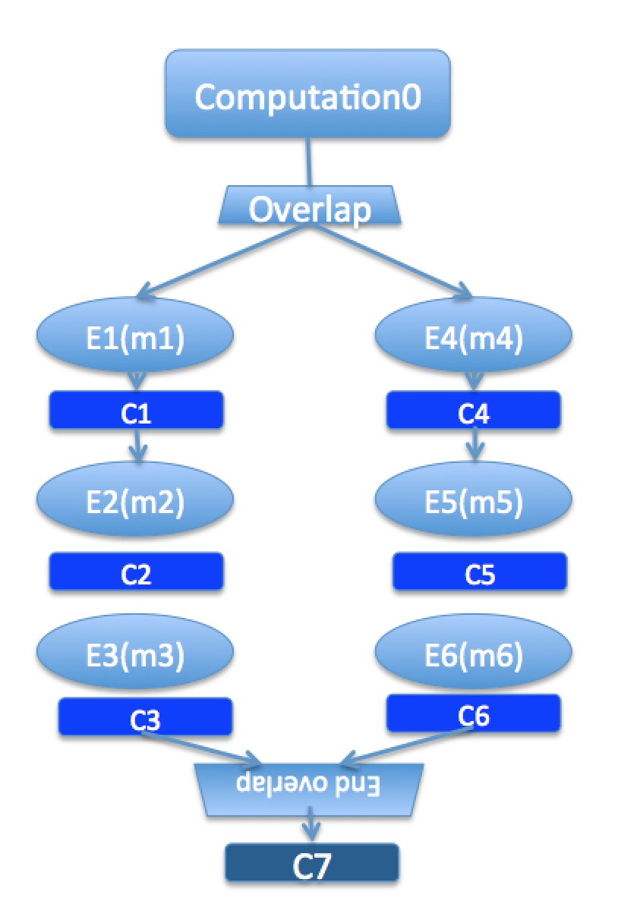
Illustration of a long “overlap”
Overlap can be used to get back some of the asynchrony within a chare
But it is constrained
Makes for more disciplined programming,
with fewer race conditions

Slide 69
Structured Dagger The forall construct
The forall construct:
Has “do-all” semantics: iterations may execute an any order
Syntax:
forall [<ident>] (<min> : <max>, <stride>) <body>
The range from <min> to <max> is inclusive
forall [block] (0 : numBlocks − 1, 1) {
when method1[block](int ref, bool someVal) /∗ code block1 ∗/
}
Assume block is declared in the class as public: int block;

Slide 70
Parallel Prefix with SDAG: .ci file I
mainmodule prefix {
readonly CProxy Main mainProxy;
readonly int numElements;
mainchare Main {
entry Main(CkArgMsg∗ msg);
entry [reductiontarget] void checkIn();
};
array [1D] Prefix {
entry Prefix();
entry void passValue(int step, unsigned int incomingValue);

Slide 71
Parallel Prefix with SDAG: .ci file II
entry void startPrefixCalculation() {
for(stage = 0; (1 << stage) < numElements; stage++) {
serial ”send value” {
targetIndex = thisIndex + (1<<stage);
if (targetIndex < numElements)
thisProxy[targetIndex].passValue(stage, value);
}
if (thisIndex >= (1<<stage))
when passValue[stage] (int incoming stage, unsigned int incoming value) serial
{
value += incoming value;
}
}
serial ”done” {
contribute(CkCallback(CkReductionTarget(Main, checkIn), mainProxy));
}
};
};
};

Slide 72
Parallel Prefix with SDAG: .C file I
#include ”prefix.decl.h”
#include <stdlib.h>
/∗ readonly ∗/ CProxy Main mainProxy;
/∗ readonly ∗/ int numElements;
class Main : public CBase Main {
public:
CProxy Prefix prefixArray;
Main(CkArgMsg∗ msg) {
if (msg−>argc > 1) numElements = atoi(msg−>argv[1]);
mainProxy = thisProxy;
prefixArray = CProxy Prefix::ckNew(numElements);
prefixArray.startPrefixCalculation();
}
Main(CkMigrateMessage∗ msg) { }
void checkIn() {
CkExit();
}
};

Slide 73
Parallel Prefix with SDAG: .C file II
class Prefix : public CBase Prefix {
Prefix SDAG CODE
public:
int stage, targetIndex, value;
Prefix() {
srand(thisIndex);
value = rand() % 10; // Random positive int between 0 and 9 (inclusive)
}
Prefix(CkMigrateMessage ∗msg) { }
};
#include ”prefix.def.h”

Slide 74
Stencil Codes
Iterative applications where array elements are updated according to some fixed pattern.
Used in computational simulations, solving partial differential equations, Jacobi kernel, GaussSeidel method, image processing applications etc.
Can be 2D or 3D

Slide 75
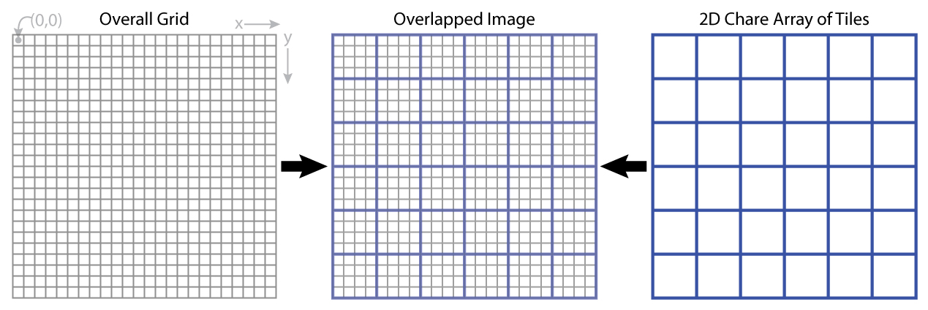
5-point Stencil

Slide 76
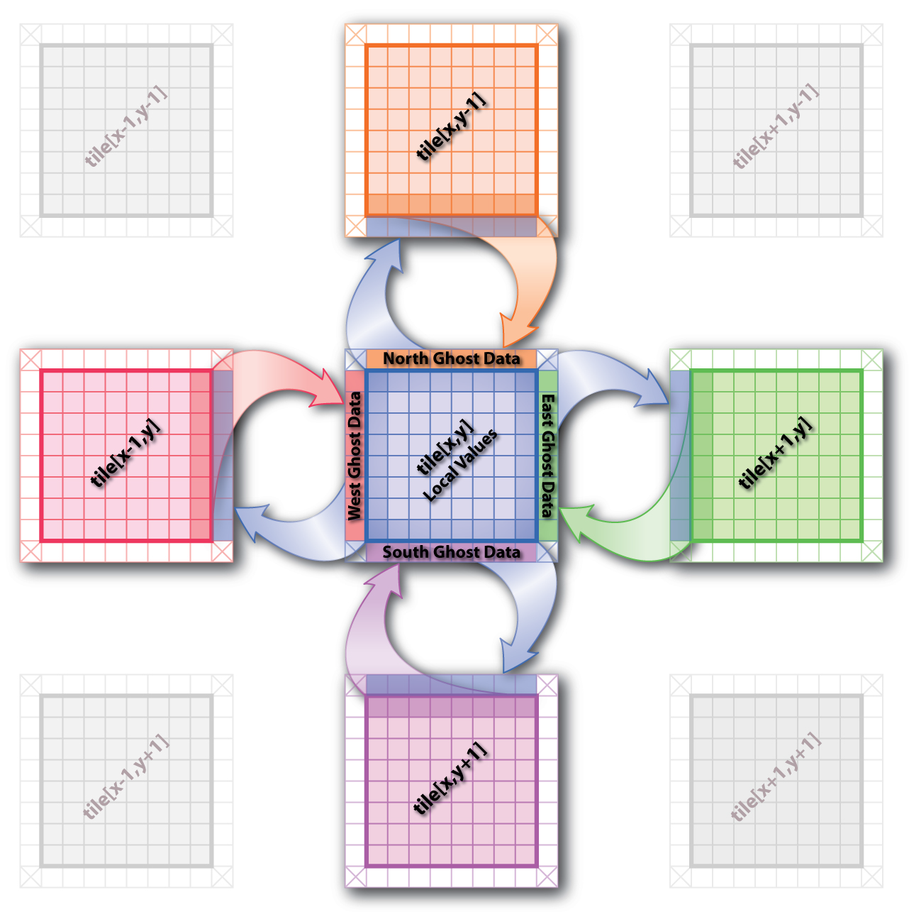
5-point Stencil

Slide 77
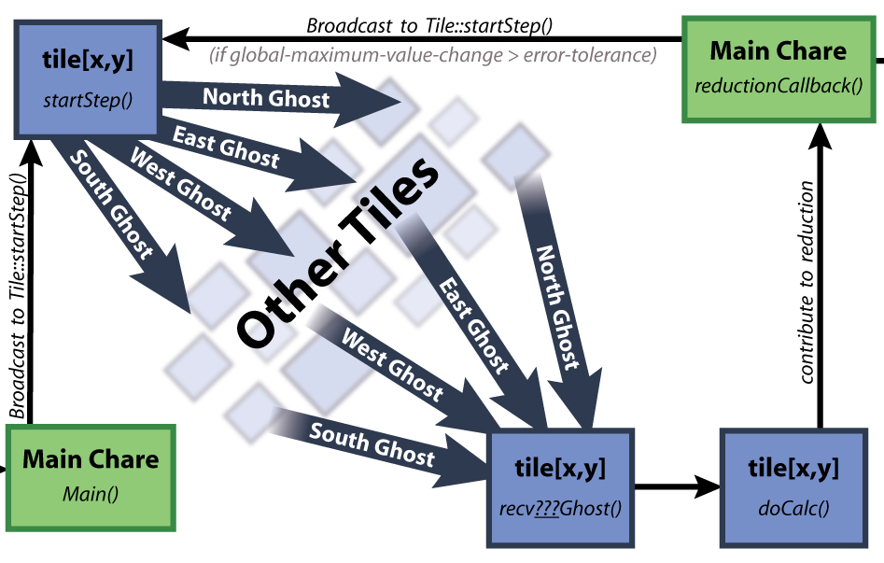
5-point Stencil

Slide 78
Jacobi: .ci file
mainmodule jacobi3d {
readonly CProxy Main mainProxy;
mainchare Main {
entry Main(CkArgMsg ∗m);
entry void done(int iterations);
};
array [3D] Jacobi {
entry Jacobi(void);
entry void updateGhosts(int ref, int dir, int w, int h, double gh[w∗h]);
entry [reductiontarget] void checkConverged(bool result);
entry void run() {
// ... main loop (next slide) ...
};
};
};

Slide 79
Jacobi: .ci file
entry void run() {
while (!converged) {
serial {
copyToBoundaries();
int x = thisIndex.x, y = thisIndex.y, z = thisIndex.z;
int bdX = blockDimX, bdY = blockDimY, bdZ = blockDimZ;
thisProxy(wrapX(x−1),y,z).updateGhosts(iter, RIGHT, bdY, bdZ, rightGhost);
thisProxy(wrapX(x+1),y,z).updateGhosts(iter, LEFT, bdY, bdZ, leftGhost);
thisProxy(x,wrapY(y−1),z).updateGhosts(iter, TOP, bdX, bdZ, topGhost);
thisProxy(x,wrapY(y+1),z).updateGhosts(iter, BOTTOM, bdX, bdZ, bottomGhost);
thisProxy(x,y,wrapZ(z−1)).updateGhosts(iter, BACK, bdX, bdY, backGhost);
thisProxy(x,y,wrapZ(z+1)).updateGhosts(iter, FRONT, bdX, bdY, frontGhost);
freeBoundaries();
}
for (remoteCount = 0; remoteCount < 6; remoteCount++)
when updateGhosts[iter](int ref, int dir, int w, int h, double buf[w∗h]) serial {
updateBoundary(dir, w, h, buf);
}
serial {
double error = computeKernel();
int conv = error < DELTA;
CkCallback cb(CkReductionTarget(Jacobi, checkConverged), thisProxy);
contribute(sizeof(int), &conv, CkReduction::logical and, cb);
}
when checkConverged(bool result)
if (result) serial { mainProxy.done(iter); converged = true; }
serial { ++iter; }
}
};

Slide 80
Jacobi: .ci file (with asynchronous reductions)
entry void run() {
while (!converged) {
serial {
copyToBoundaries();
int x = thisIndex.x, y = thisIndex.y, z = thisIndex.z;
int bdX = blockDimX, bdY = blockDimY, bdZ = blockDimZ;
thisProxy(wrapX(x−1),y,z).updateGhosts(iter, RIGHT, bdY, bdZ, rightGhost);
thisProxy(wrapX(x+1),y,z).updateGhosts(iter, LEFT, bdY, bdZ, leftGhost);
thisProxy(x,wrapY(y−1),z).updateGhosts(iter, TOP, bdX, bdZ, topGhost);
thisProxy(x,wrapY(y+1),z).updateGhosts(iter, BOTTOM, bdX, bdZ, bottomGhost);
thisProxy(x,y,wrapZ(z−1)).updateGhosts(iter, BACK, bdX, bdY, backGhost);
thisProxy(x,y,wrapZ(z+1)).updateGhosts(iter, FRONT, bdX, bdY, frontGhost);
freeBoundaries();
}
for (remoteCount = 0; remoteCount < 6; remoteCount++)
when updateGhosts[iter](int ref, int dir, int w, int h, double buf[w∗h]) serial {
updateBoundary(dir, w, h, buf);
}
serial {
double error = computeKernel();
int conv = error < DELTA;
if (iter % 5 == 1)
contribute(sizeof(int), &conv, CkReduction::logical and, CkCallback(CkReductionTarget(Jacobi,
checkConverged), thisProxy));
}
if (++iter % 5 == 0)
when checkConverged(bool result)
if (result) serial { mainProxy.done(iter); converged = true; }
}
};

Slide 81
Power of Asynchrony Example
Consider the following problem:
A large number of key-value pairs are distributed on several (hundred) processors (or chares)
Each chare needs to get some subset of these values before they can proceed to the next phase of the computation
The set of keys needed are not known in advance: they are determined based on the input data

Slide 82
Structured dagger version
entry void retrieveValues {
for (i = 0; i < n; i++) serial {
keys[i] = // compute i’th key;
keyValueProxy[keys[i] / B].requestValue(keys[i], thisProxy, i);
}
for (i = 0; i < n; i++)
when response(int i, ValueType value)
serial { values[i] = value; }
};
// next phase of computation thats uses the keys and values.
KeyValueClass::requestValue(int key, CProxy Client c, int ref) {
ValueType v = localTable[key];
c.response(ref, v);
}

Slide 83
Outline
Introduction
Object Design
Execution Model
Hello World
Benefits of Charm++
Charm++ Basics
Object Collections
Overdecomposition
Migratability
Checkpointing and Resilience
Structured Dagger
Application Design
Performance Tuning
Using Dynamic Load Balancing
Interoperability
Debugging
Further Optimization

